Slide 1

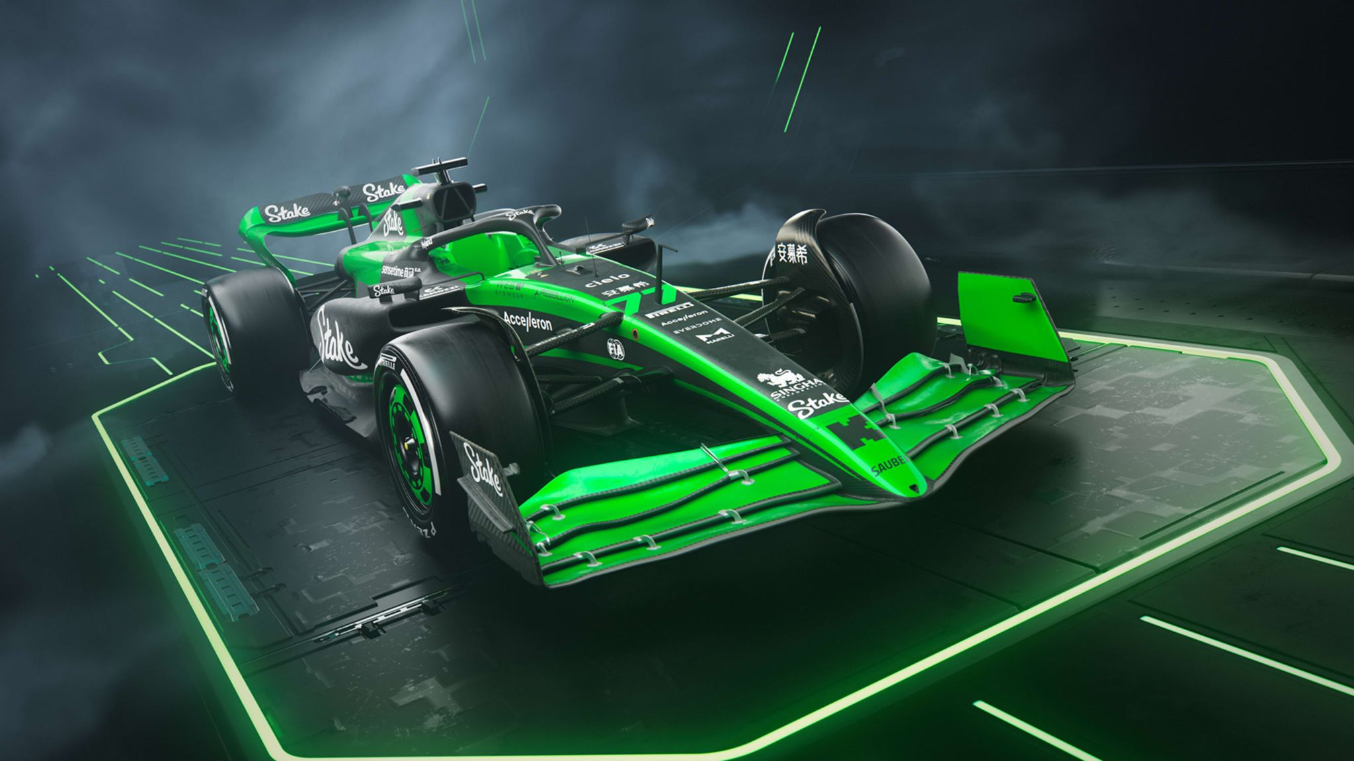
Data Analysis in F1

Slide 2

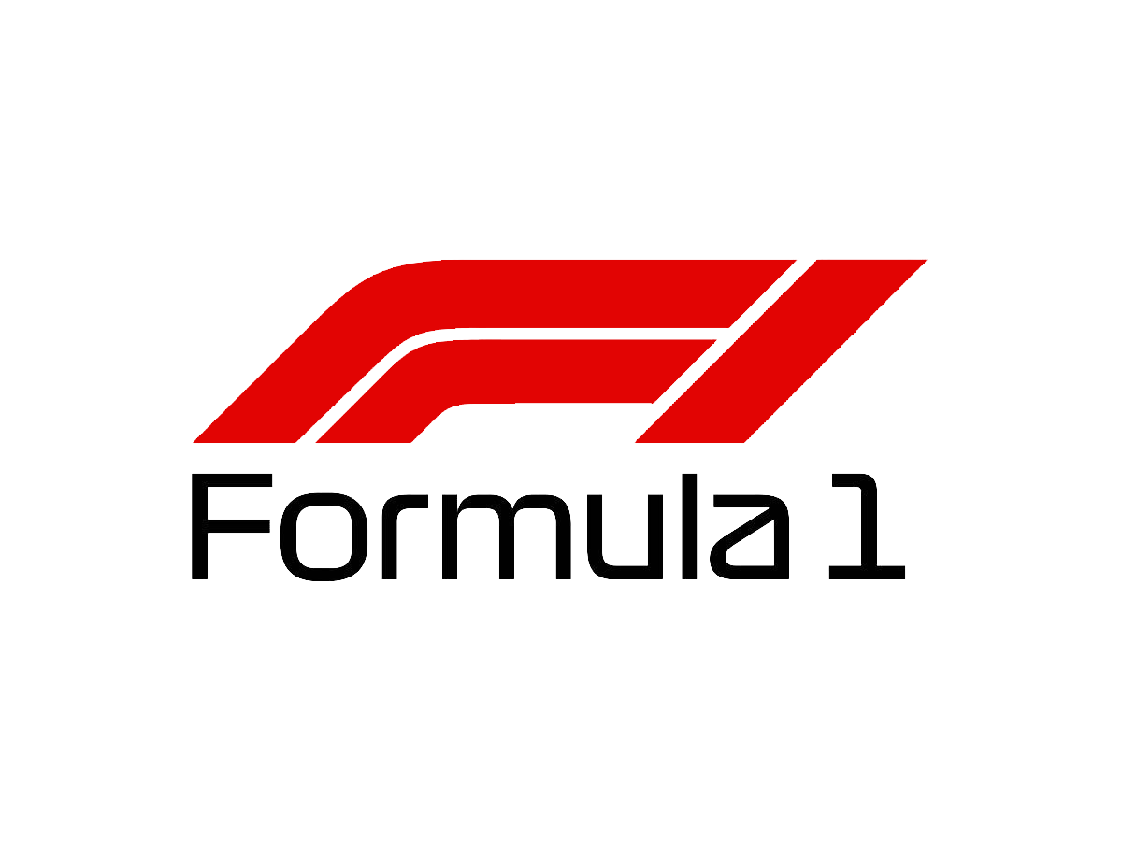

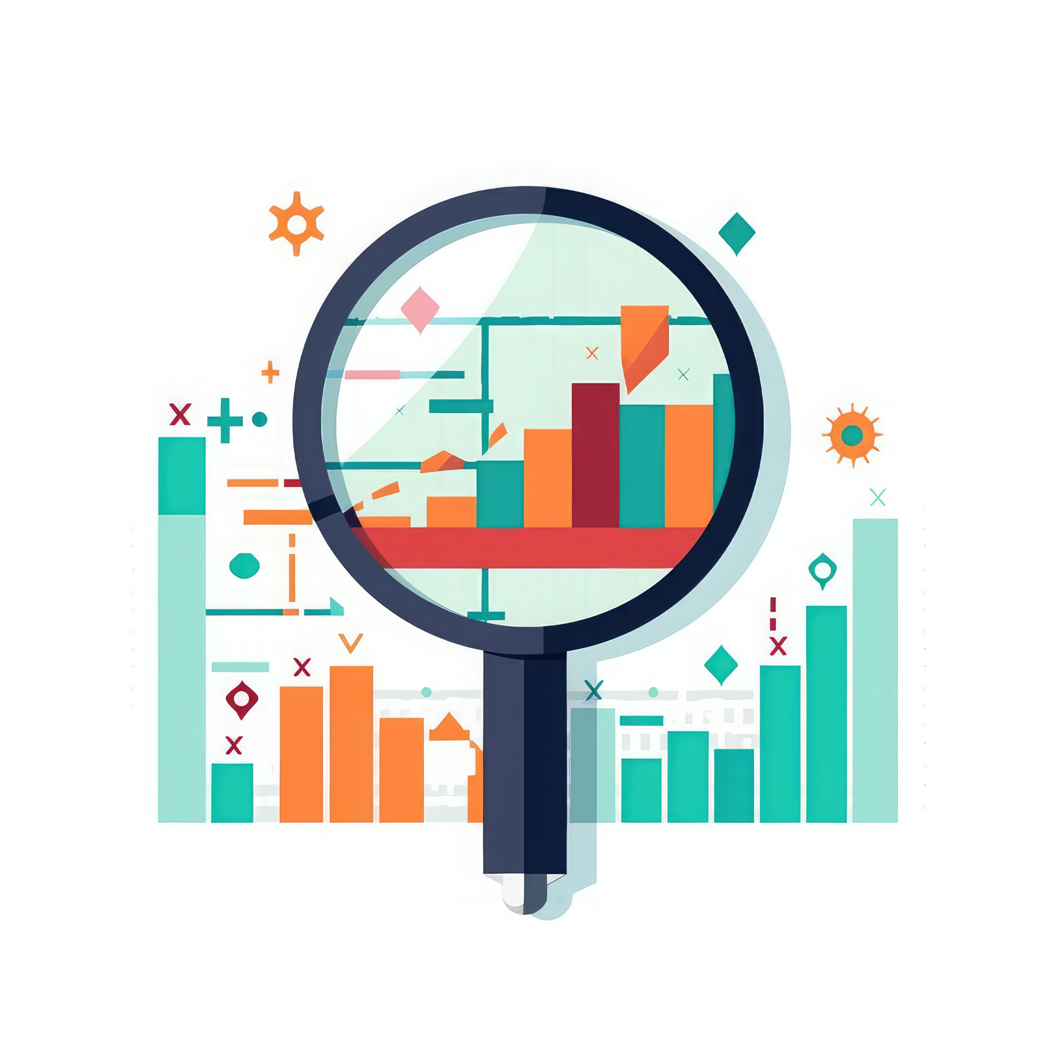

Project Overview
February 2025
F1
API
Python
Algorithm

Slide 3
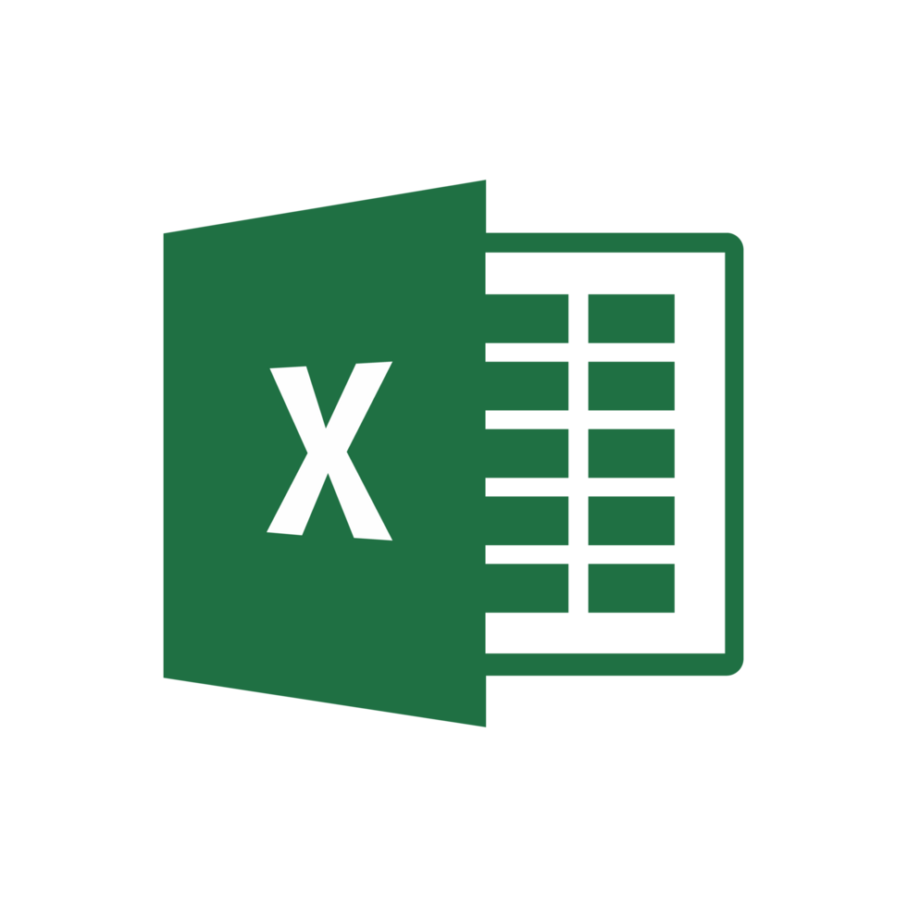

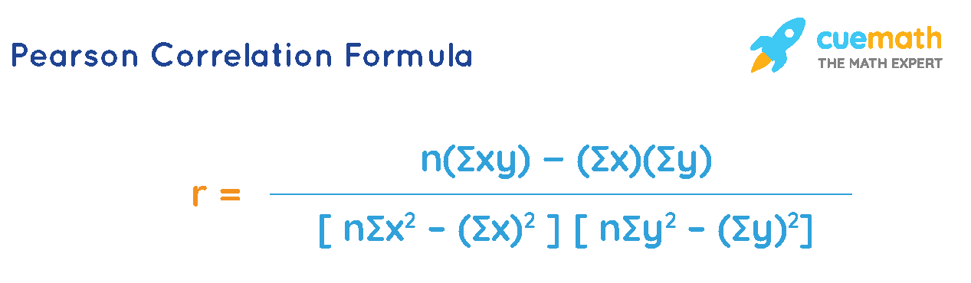
Research so Far
February 2025
Gather Data from API
Pandas
Make a functions that access OpenF1 API, and fetch the race information.
Python library that allow us to easily work with the data. Cleaning, Manipulate, Organized, Filtering, Merging and other.
Read, Write, Organized Excel using Python
Correlation Methods
What kind of methods can be used to check for the correlation between variables.
Make a function that export data frame into excel format, and be able to read excel.

Slide 4
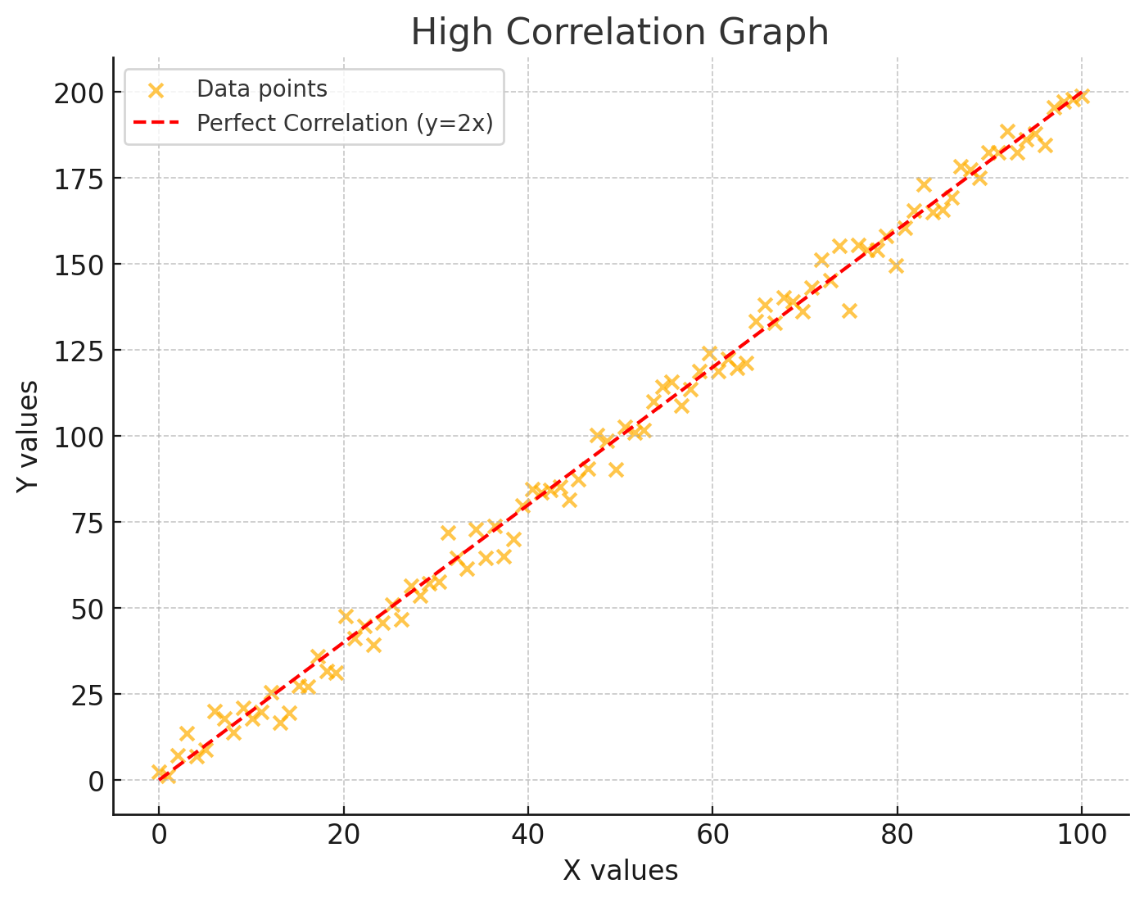
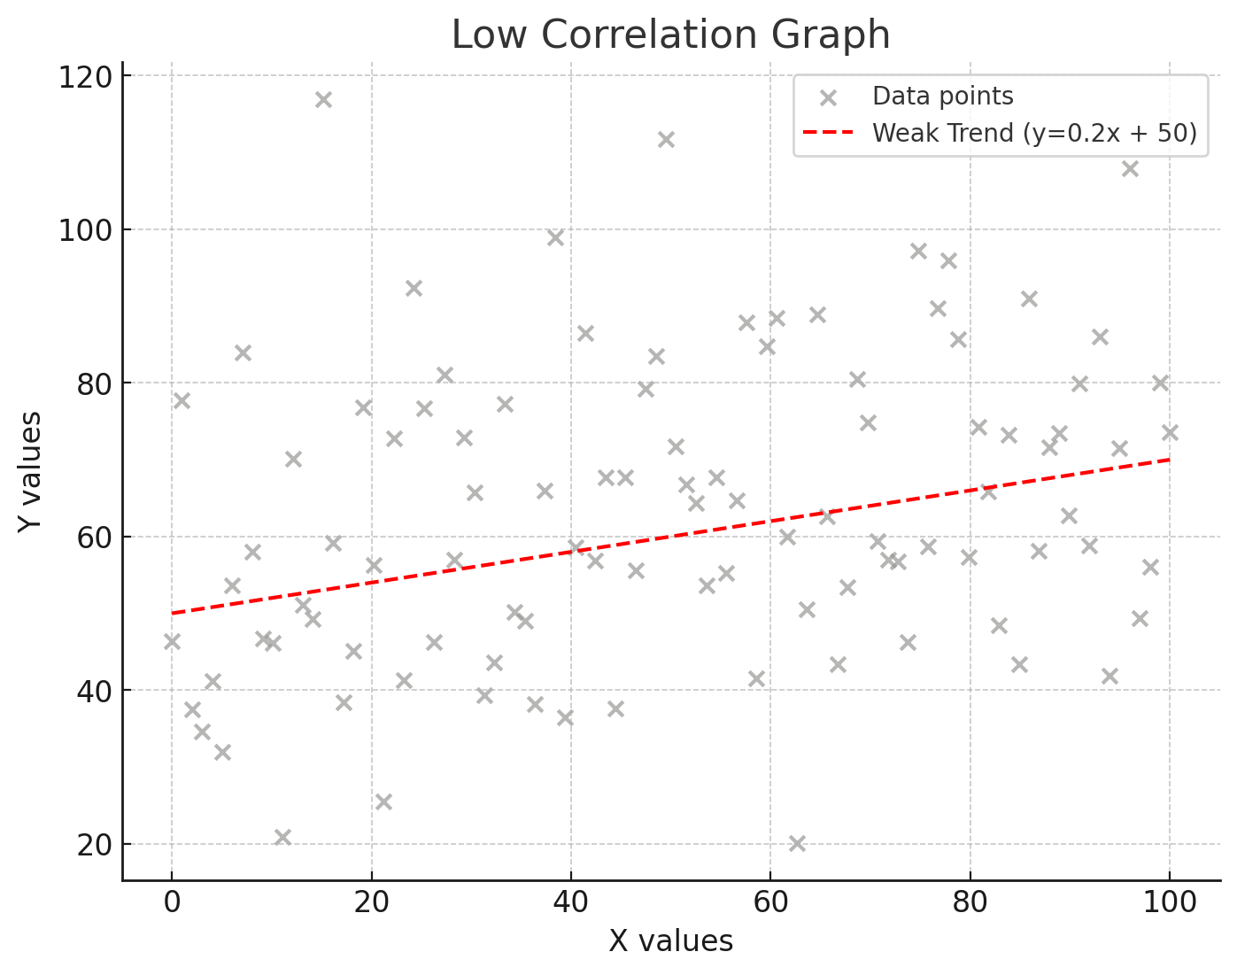
Pearson Correlation
February 2025
High Correlation
High Correlation show strong linear relationship.
Example: Height vs Weight Age vs Wealth
r val range from -1 to 1
Low Correlation
Low Correlation means it show a weak linear relationship.
Example: Shoe Size vs IQ Height vs Speed
Close to 0
Example of
High Correlation Graph r = 0.997
Example of
Low Correlation Graph r = 0.277

Slide 5
Result
February 2025
Average Lap Duration vs Winning Position
This should have high linear relationship, since the faster you’re, the more likely you’re going to win
Race 1
Race 2
Race 3
r val = -0.007
r val = 0.551
r val = 0.992
Very Low Correlation
Very Bad :(
Low Correlation
Bad
Great Correlation
Good
Notes:
1 = Qatar 2023
2 = Mexico 2024
3 = Spain 2024

Slide 6
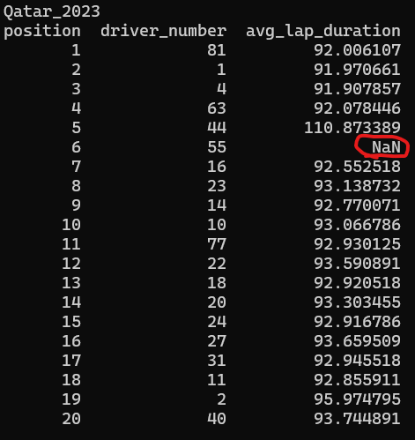
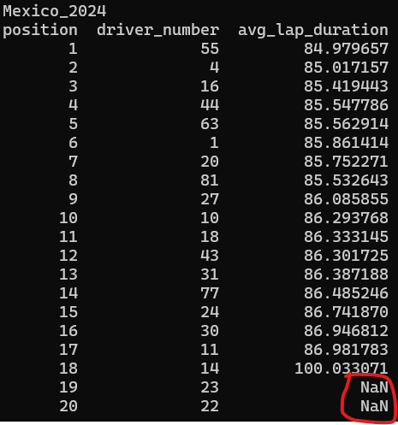
February 2025
Notes:
Show data error

Slide 7



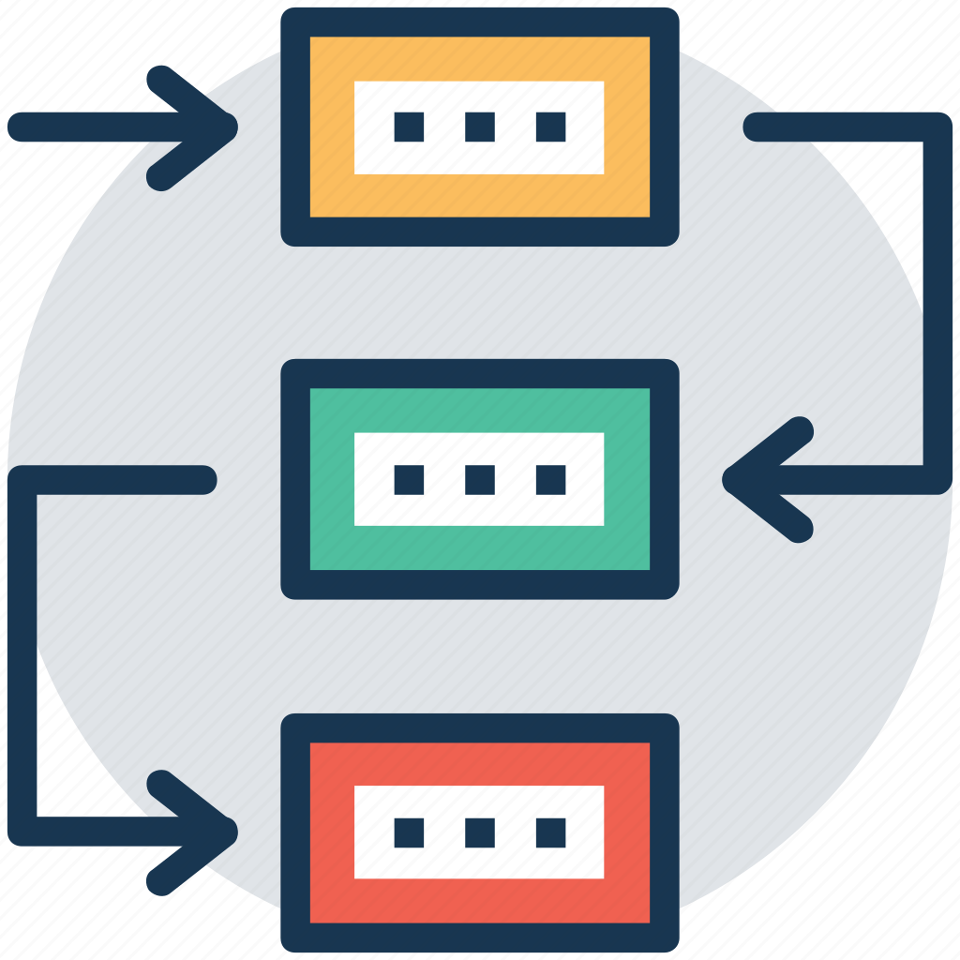
Obstacles
API Limitation
Cleaning Data
Organized Data
Different Methods

Slide 8
Where to go from here
February 2025
Store Data Locally
Explore Pandas Library
Make a functions that access OpenF1 API, and fetch the race information, and export to excel.
What kind of methods is available to support the project
Read & Write
Excel Files with Python
Use Different Methods
Pearson
Spearman
Kendall
Make a function that export data frame into excel format, and be able to read excel.

Slide 9
Thank You!
Reference
February 2025
https://ar.inspiredpencil.com/pictures-2023/microsoft-excel-logo-png
https://www.cuemath.com/Pearson-correlation-formula/
https://samuelsum.com/trends-in-data-science-for-2020-2021/
https://www.formula1.com/en/latest/article/gallery-every-angle-of-kick-saubers-bold-new-look-for-the-2024-season.EGk2uWFgMmkqKutbGnDUi
https://cdn.wallpaperdirect.com/asset/img/product/186315/tiled/galerie-hessian-effect-green-wallpaper-tiled-186315.jpg
https://www.iconfinder.com/icons/2689605/method_procedure_planning_process_flow_scheme_technique_icon
https://www.freepik.com/icon/data-cleaning_10179118
https://www.freepik.com/icon/research_2345308
https://www.aiophotoz.com/photos/formula-1-new-logo-transparent-png-stickpng.html
https://www.vecteezy.com/png/25218132-isometric-employees-managing-documents-file-folders

